Slide 1
Topic: Geometry and Mapping EQ: How can we use map scales to figure out real life distances?
Year 11 Mathematics Essentials

Slide 2
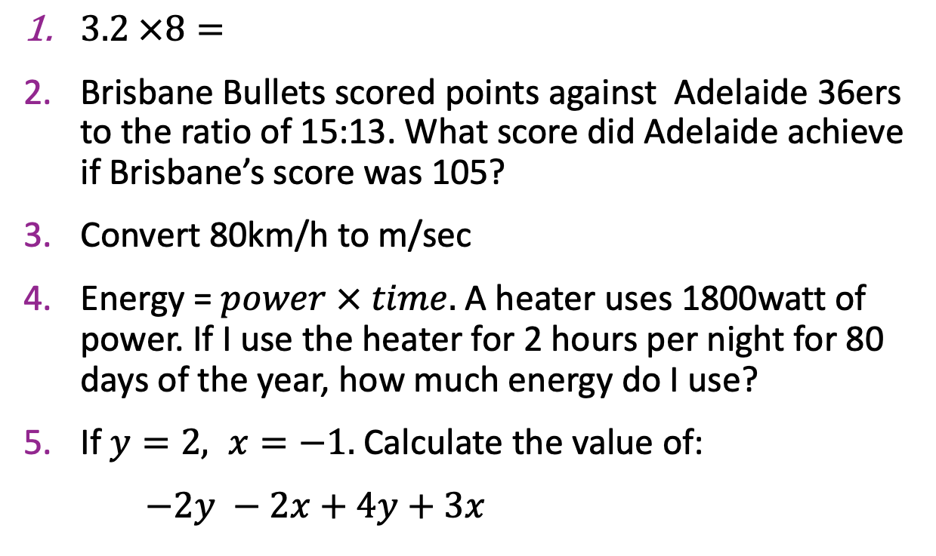
Five Questions
Topic: Geometry and Mapping
EQ – How can we apply our knowledge of scale ratios to figure out real life distances?
$3.2 ×8=$
Brisbane Bullets scored points against Adelaide 36ers to the ratio of 15:13. What score did Adelaide achieve if Brisbane’s score was 105?
Convert 80km/h to m/sec
Energy = $power × time.$ A heater uses 1800watt of power. If I use the heater for 2 hours per night for 80 days of the year, how much energy do I use?
If $y=2, x=−1.$ Calculate the value of:
$−2y −2x+4y+3x$
25.6
91
1 334m/sec (rounded)
1.8kw x 2h x 80 days. =288kwh
3

Slide 3
24
7
30
Date: XX/XX/2021
Topic: Geometry and Mapping
EQ – How can we apply our knowledge of scale ratios to figure out real life distances?
Most new cars today have a built in GPS. Our phones have multiple apps for directions. But what happens when we need to use an alternate route due to an accident or trusty Google Maps has given us a dodgy route?
We use what those of us born in the 90’s and below call a street directory. Street maps have a grid, coordinate system to help us locate features. We read coordinates by starting with:
The horizontal (across) letters, then the vertical (up and down) letters
WICOR

Slide 4
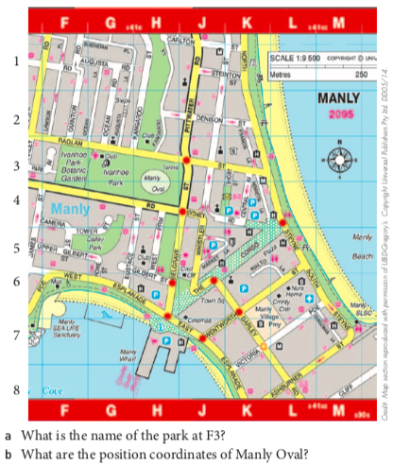

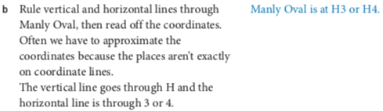
24
7
30
Practice
Topic: Geometry and Mapping
EQ – How can we apply our knowledge of scale ratios to figure out real life distances?
WICOR

Slide 5
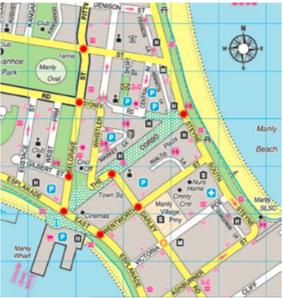
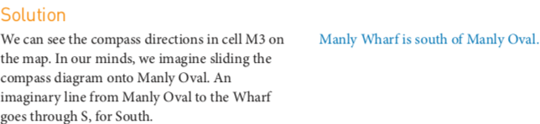
24
7
30
Practice
Topic: Geometry and Mapping
EQ – How can we apply our knowledge of scale ratios to figure out real life distances?
What direction, as the crow flies, is it from Manly Oval to Manly wharf?
(The expression ‘as the crow flies’ means ‘in a straight line’).
WICOR

Slide 6
Further Practice:
Complete the worksheet on reading maps
Notes:
If you need an extra lesson, there are worksheets available on connect.

